Slide 1

Basic of C Programming
Formatted Input/Output

Slide 2

printf() and scanf() in C -
The printf() and scanf() functions are used for input and output in C language. Both functions are inbuilt library functions, defined in stdio.h (header file).
printf() function -
The printf() function is used for output. It prints the given statement to the console.
printf("format string", argument_list);
scanf() function –
The scanf() function is used for input. It reads the input data from the console.
scanf("format string", argument_list);

Slide 3

Programming Errors -
Errors are the problems or the faults that occur in the program, which makes the behavior of the program abnormal, and experienced developers can also make these faults.
Programming errors are also known as the bugs or faults, and the process of removing these bugs is known as debugging.
These errors are detected either during the time of compilation or execution. Thus, the errors must be removed from the program for the successful execution of the program.

Slide 4
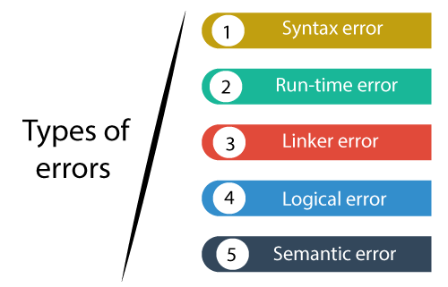

Programming Errors -
There are mainly five types of errors exist in C programming –

Slide 5
Syntax Error -
Syntax errors are also known as the compilation errors as they occurred at the compilation time, or we can say that the syntax errors are thrown by the compilers.
These errors are mainly occurred due to the mistakes while typing or do not follow the syntax of the specified programming language.
These mistakes are generally made by beginners only because they are new to the language.
These errors can be easily debugged or corrected.

Slide 6

Example of Syntax Error -
#include<stdio.h>
void main()
{
a = 10; //int datatype missing
printf("The value of a is : %d", a);
}

Slide 7

Runtime Error -
Sometimes the errors exist during the execution-time even after the successful compilation known as run-time errors.
When the program is running, and it is not able to perform the operation is the main cause of the run-time error.
The division by zero is the common example of the run-time error.
These errors are very difficult to find, as the compiler does not point to these errors.

Slide 8

Example of Runtime Error -
#include <stdio.h>
int main()
{
int a=2;
int b=2/0; // divide by zero error
printf("The value of b is : %d", b);
return 0;
}

Slide 9

Thank you!

